Slide 1

Status of Statistics Curricula in Canada
Sotirios Damouras & Sohee Kang

Slide 2
Data Sources
Stats program enrolments/graduates: Postsecondary Student Information System (PSIS) survey, from Statistics Canada
Microdata available through StatCan’s RTRA
Stats program curricula: collected from universities’ calendars
Many thanks to Olivia Rennie (UTSC NeuroSci BSc) for her help
All data & code available through GitHub
https://github.com/damouras/SoSC

Slide 3
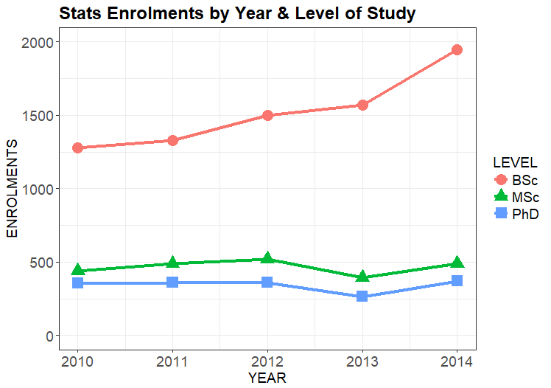
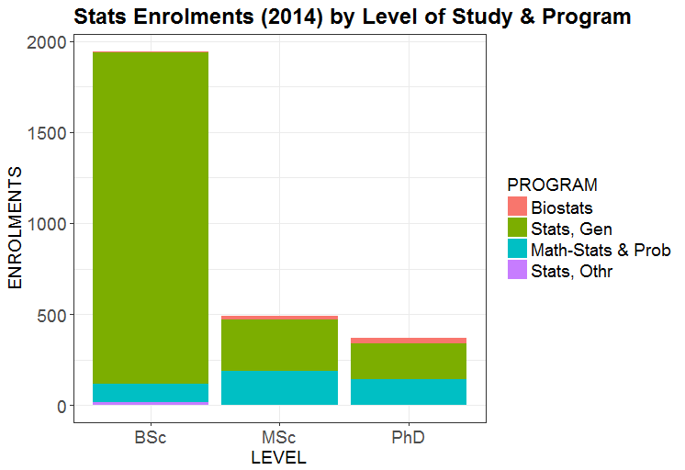
Stats Programs Vital Statistics
52% increase in Stats BSc
enrolments (`10 to `14)
Majority of BSc’s in
General Statistics
Notes:
Growth of
Twice as many BSc than MSc graduates! Contrast to US :
twice as many BSc grads per capita in Canada ( (375/36)/(1700/321) ~ 2)
Similar total grads ( (600/36)/(5000/321) ~ 1)

Slide 4
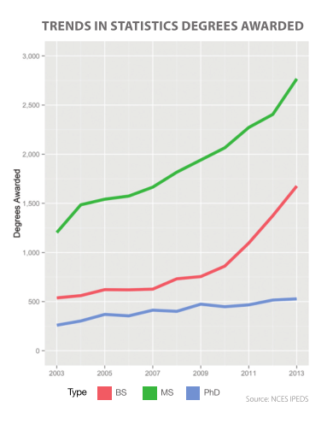
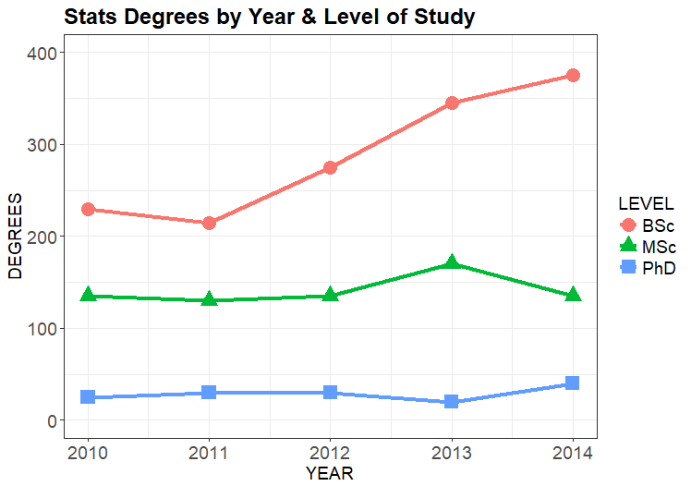
Stats Programs Vital Statistics
Different from US,
where MSc > BSc
>2 times more BSc
than MSc+PhD grads
CANADA
USA
(reproduced from 2014 ASA Curriculum Guidelines
for Undergraduate Programs in Statistical Science)

Slide 5
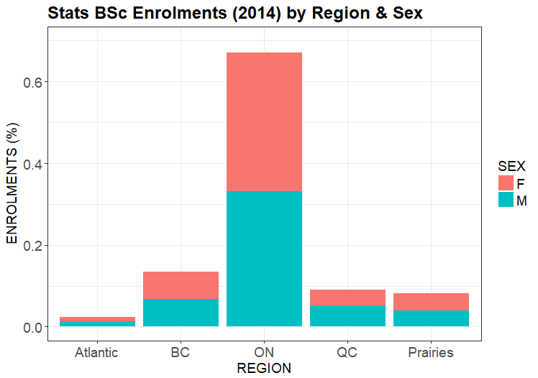
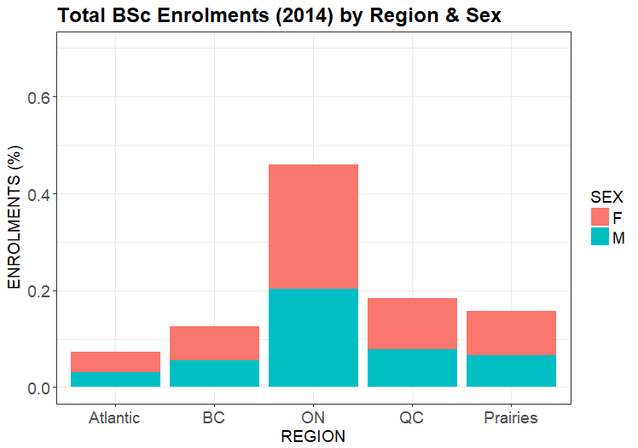
Stats BSc Enrolment Breakdown
Gender Parity!
(F/M = 970/975)
ON has relatively more Stats BSc’s;
Atlantic/QC/Prairies have less
Stats BSc
All BSc

Slide 6
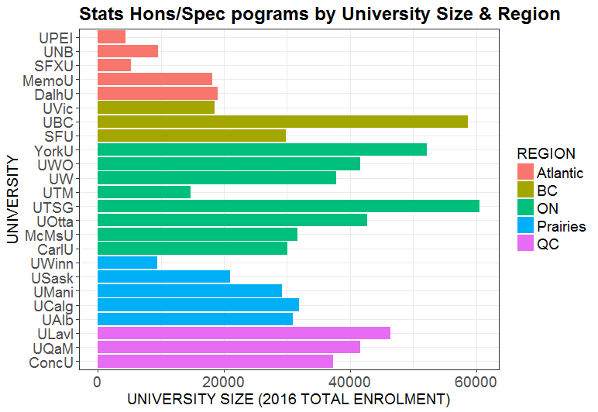
Stats Curricula - Target Population
Consider only (pure) Statistics Honours/Specialist programs
Excludes Minors, 3-yr BSc, etc
Excludes programs not focused purely on Statistics (e.g. Probability & Statistics, or Mathematical Statistics)
Analyzed programs from n=24 Universities

Slide 7
Stats Curricula - Variable Description
For each course requirement, create variables:
Code, Title & Description: copied from calendar
Credits: 0.5 credits = one-semester course
Discipline: department/discipline offering course
One of: COMP, MATH, STAT, or OTHR
Level: “year” in which course is offered (capped at 4)
Type: Core or Elective requirement
Topic Category: multi-valued variable; subjective grouping of covered topics
One or more of:
Statistical Theory (ST) |  | Statistical Methodology (SM) |  | Statistical Practice (SP)
Mathematics (MT) | Probability (PT) |  | Computing (CS) |  | Other (OT)

Slide 8
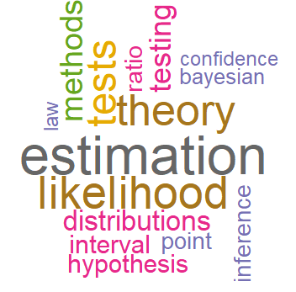
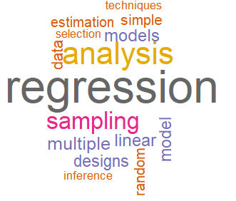
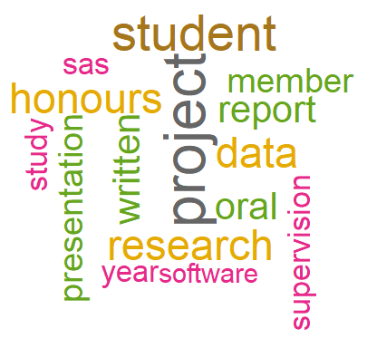
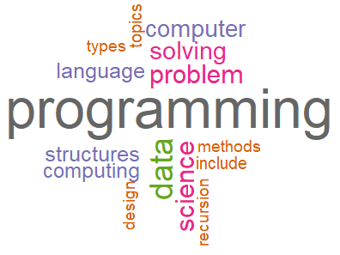
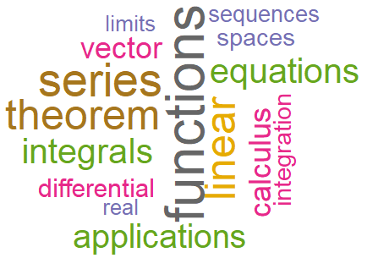
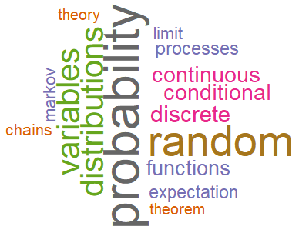
Topic Category Word Clouds
Stat Theory
Stat Methodology
Stat Practice
Computing
Mathematics
Probability

Slide 9
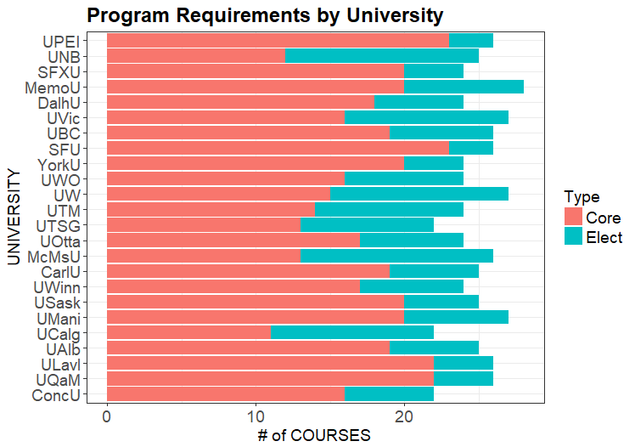
Number of Courses
25 semester courses required on average; with most programs between 24-26
i.e. 12-13 year-course equivalents, or 72-78 credit hours
70% of courses specified (core)
Most programs ranging between 60% - 80%

Slide 10
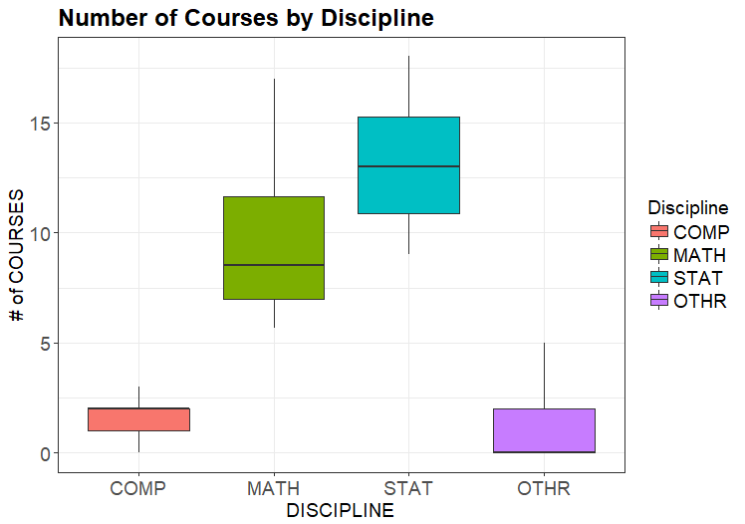
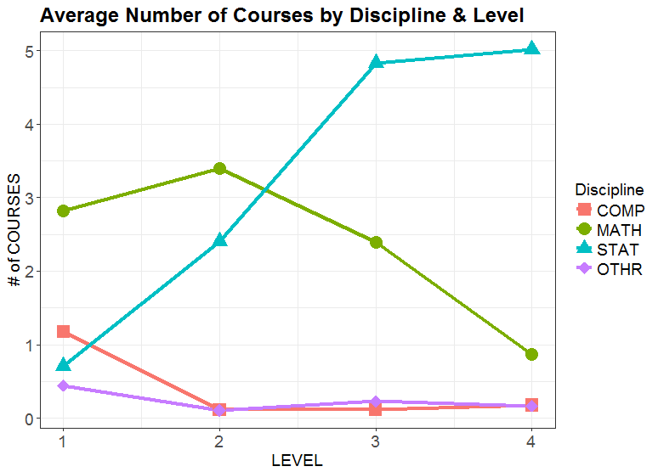
Breakdown of Courses by Discipline
52% STAT courses on average
(and 38% MATH courses)
few STAT courses in
1st year (mostly none)

Slide 11
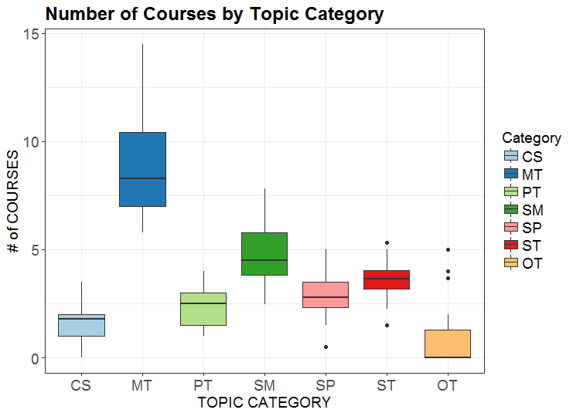
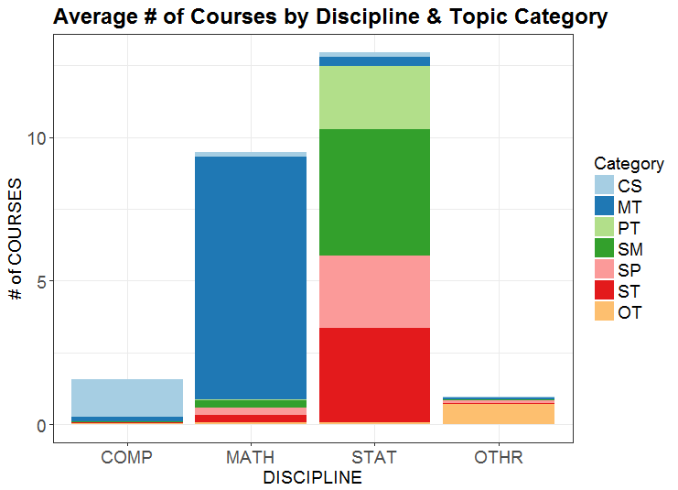
Breakdown of Courses by Topic Category
Practice is least
developed Stats category
Math/Prob-heavy curriculum

Slide 12
Conclusions/Recommendations
Train Stats BSc’s primarily for the workplace (rather than graduate school)
Offer more Stats-specific courses (at expense of Math courses)
Offer more Stats courses early on (1st year)
Place more focus on Statistical Practice / Computing

